Slide 1
PDF Knowledge graph
Miguel Yánez
Christian Dörpelkus
Jesus Hernandez
Open Science and Artificial Intelligence in Research Software Engineering ​
2023 UPM - ETSINF

Slide 2
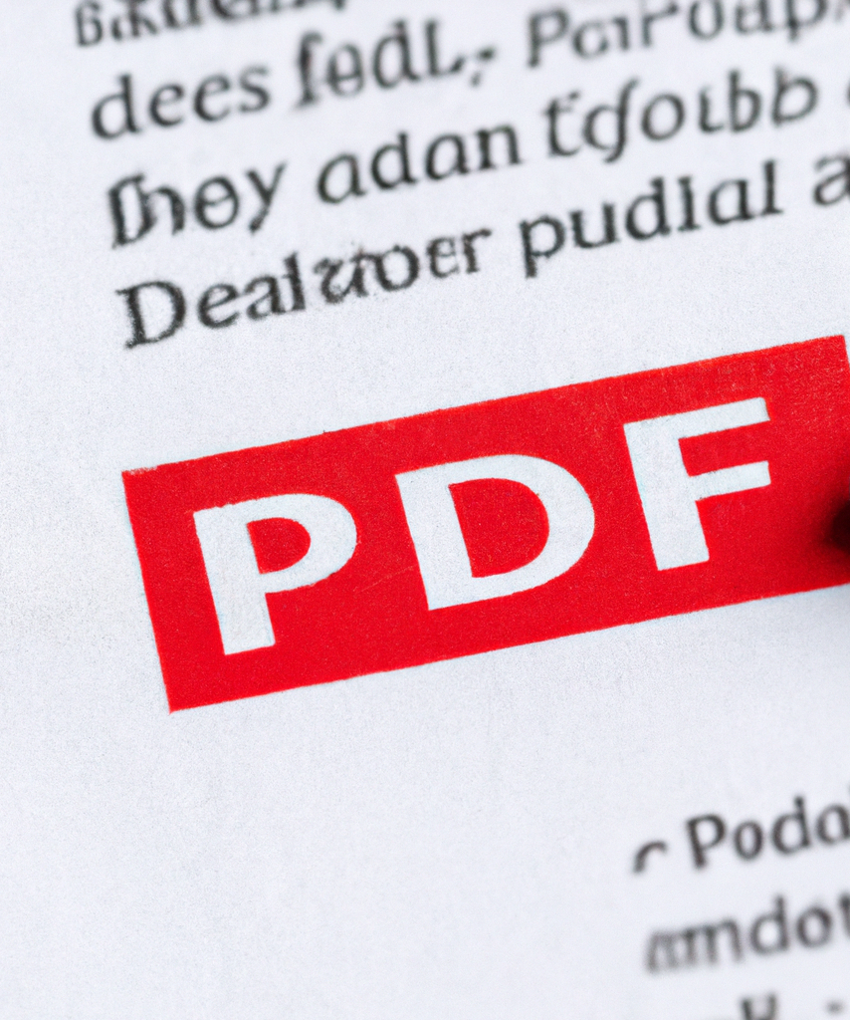
INTRODUCTION
Image generated with DALLE (https://openai.com/dall-e-2/)

Slide 3



DATASOURCES

Slide 4
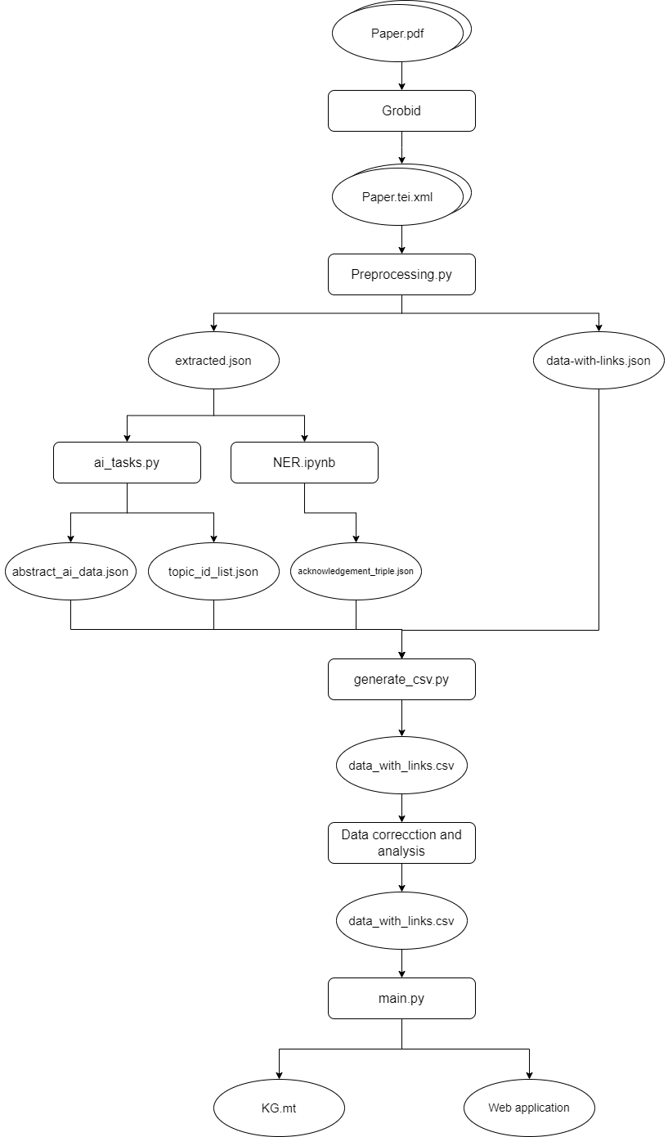
WORKFLOW PART 1

Slide 5
WORKFLOW PART 2

Slide 6
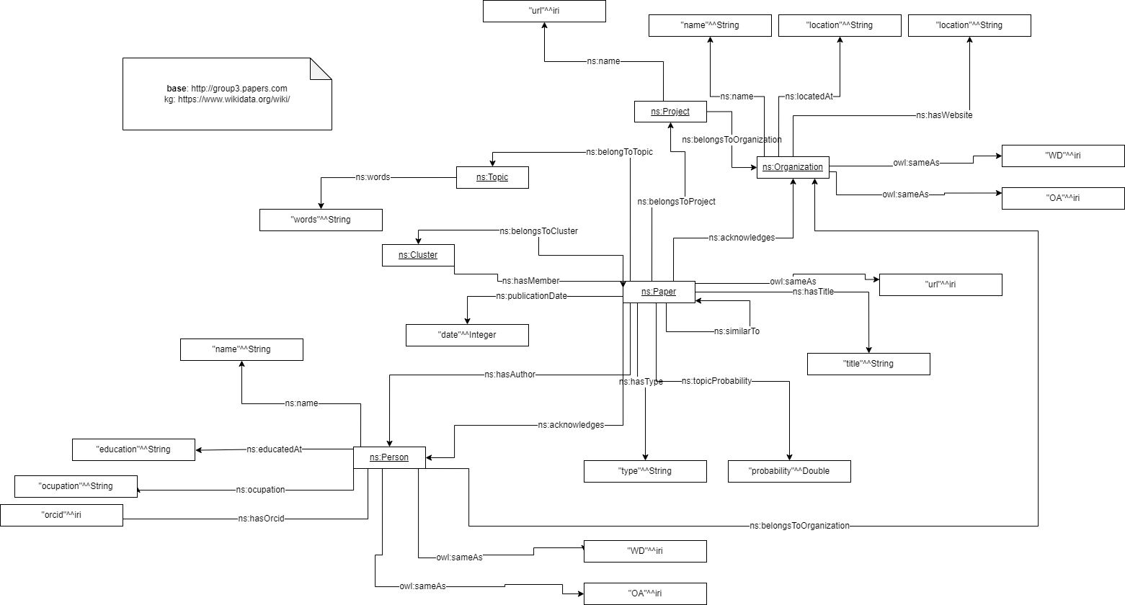
ONTOLOGY

Slide 7
APPROACH VALIDATION

Slide 8
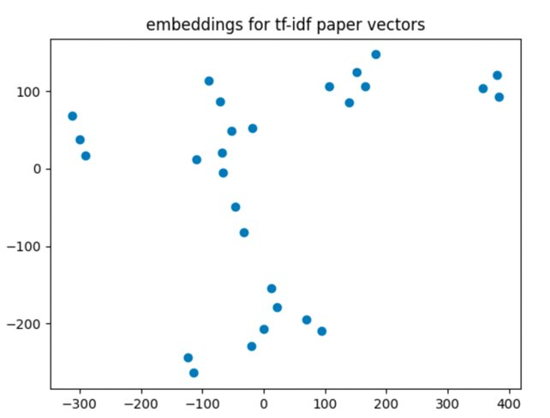
CLUSTERING AND TOPIC MODELING
Clustering:
Evaluated clusters using silhouette score
Best results for k-means
Topic modelling:
Used the LDA approach
Evaluated with c_v coherence

Slide 9
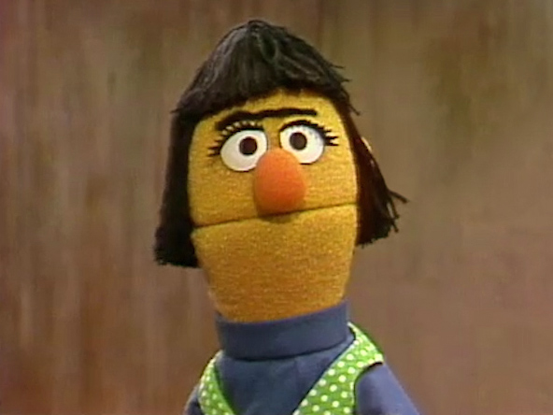

NER
Using hugginface api ​
Evaluating by applying a threshold of 0.9​
Using only PER and OG entities

Slide 10


TESTING
Unit tests.
Acceptance tests.
Image generated with DALLE (https://openai.com/dall-e-2/)

Slide 11




OPEN SCIENCE BEST PRACTICES

Slide 12
Summary
Created an Ontology
Set up and implemented a workflow
Performed AI tasks to enrich our KG
Provide an user interface to query our KG

Slide 13
THANK YOU
NOW WE WILL SHOW YOU A DEMO OF OUR APPLICATION
YOU ARE WELCOME TO CHECK OUR PROGRESS IN OUR REPOSITORY:
https://github.com/YizzaJ/PDF_Knowledge_Graph

